Slide 1

DELE CA1
PART A: CONVOLUTIONAL NEURAL NETWORK
Vegetable Image Classifier

Slide 2
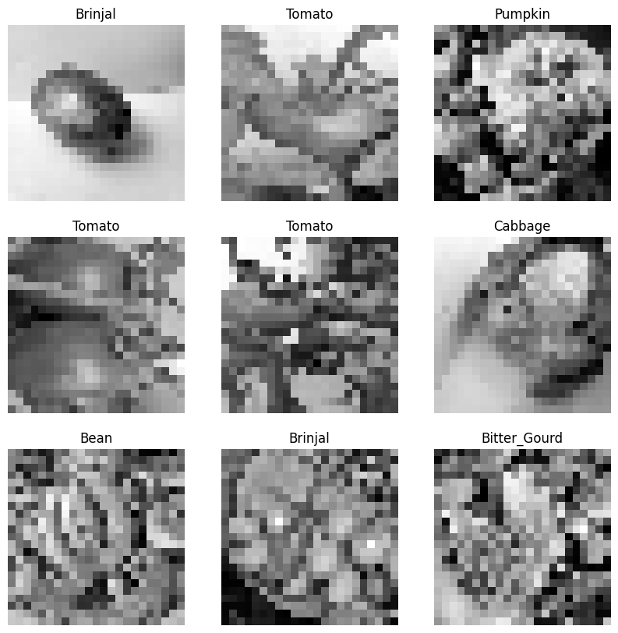
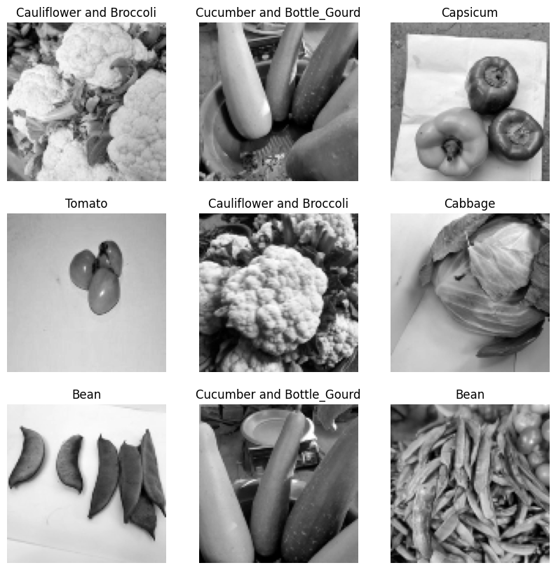
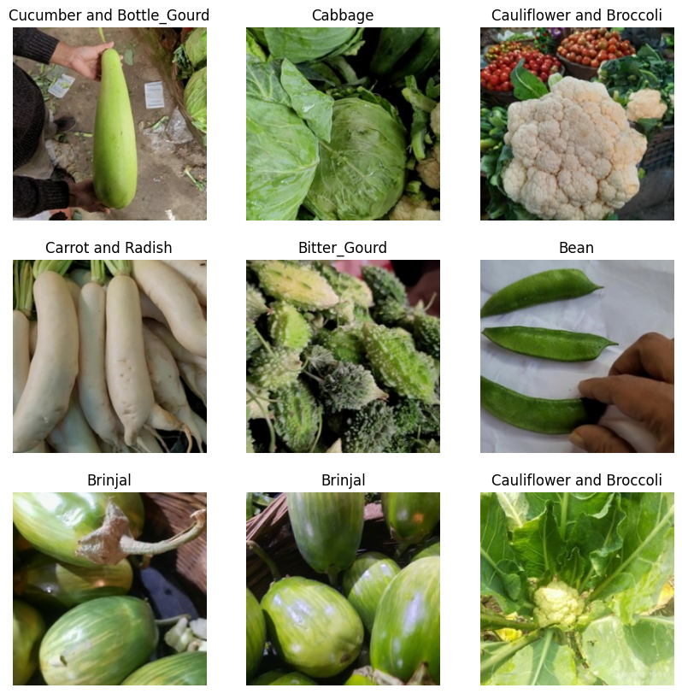
Loading Data

Slide 3
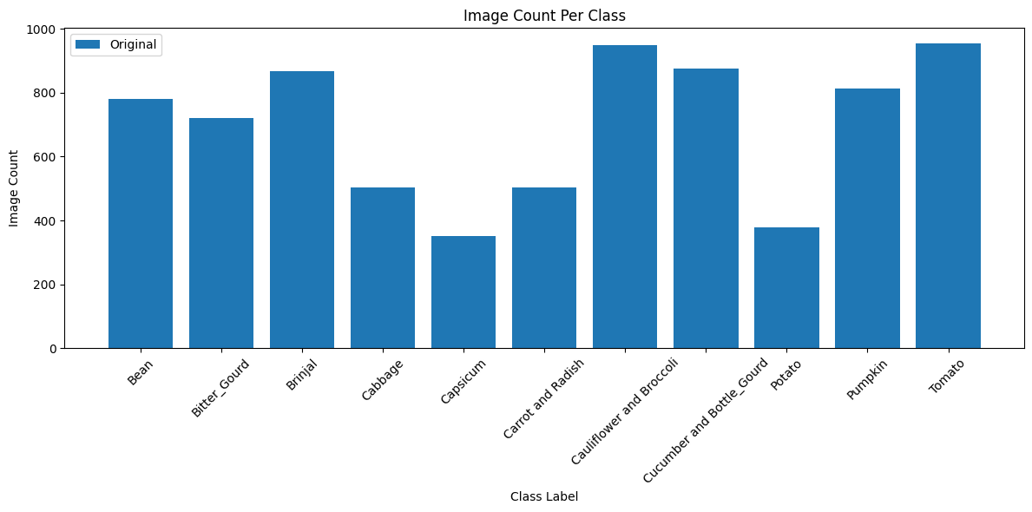
Exploratory Data Analysis (Class Imbalance)
From the chart, we can see that the number of images for each vegetable is not balanced with some having as many as 900 images and others having much less, such as Capsicum with only around 350 images
As such, we must find a way to handle this later during model training

Slide 4
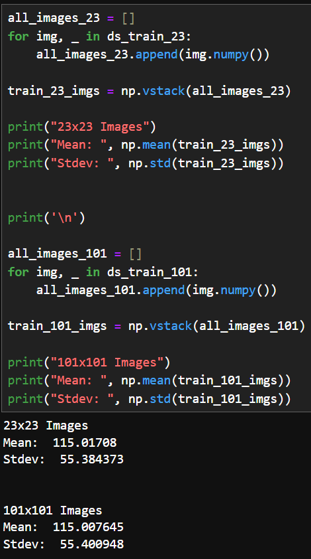
Exploratory Data Analysis (Image Pixel Distribution)
From the mean pixel value, we see that the average pixel is not very bright but there is some variation in the pixel intensity for both 23 by 23 and 101 by 101 images

Slide 5
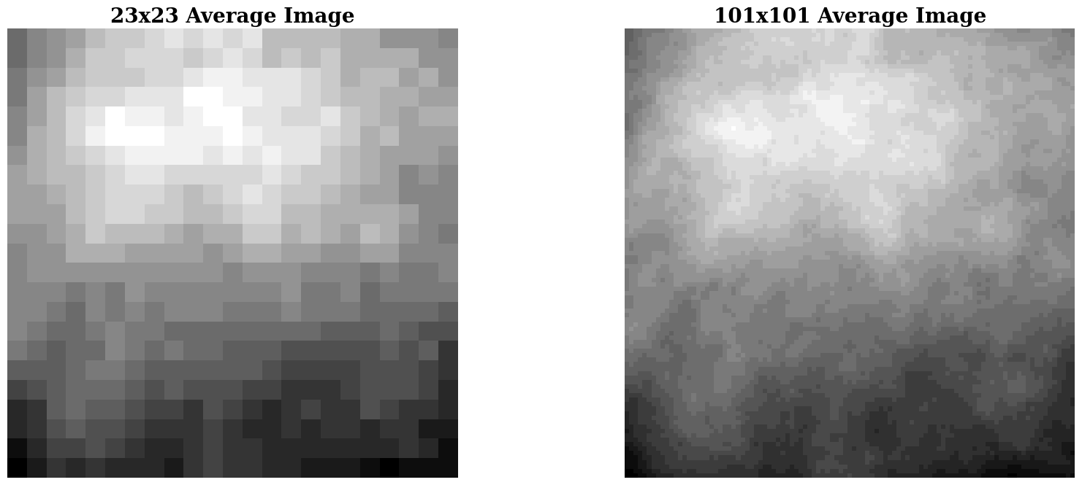
Exploratory Data Analysis (Image Averaging)
From both images we can see that generally, the brighter pixels are on top and not exactly in the middle. This means that many of the images are not all zoomed in so that the entire image only contains the specific vegetable
It seems that although the 23x23 image is not as clear compared to the 101x101 image, there are still some similar features which can be discerned when comparing the two images

Slide 6
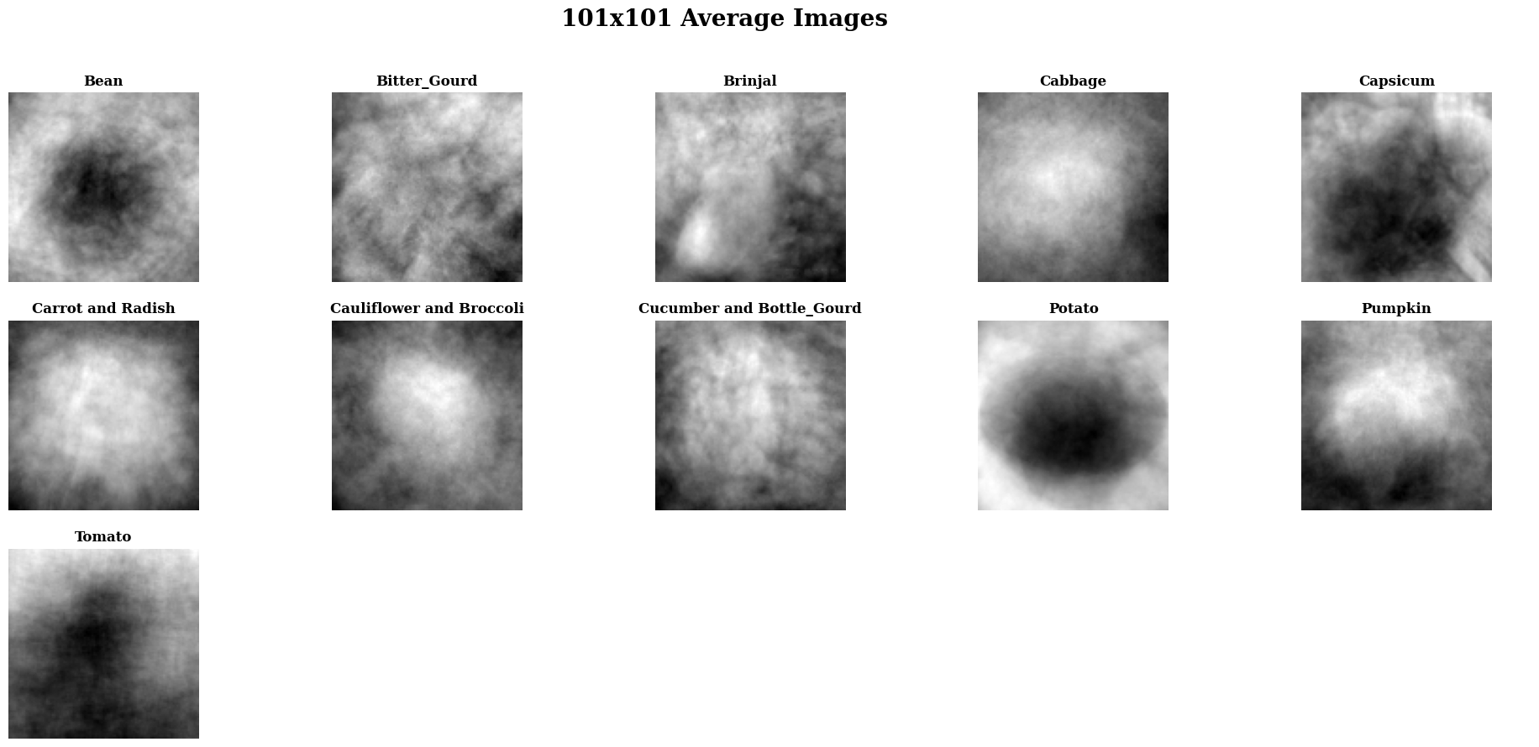

Exploratory Data Analysis (Image Averaging By Class)
From the average image of each class label, it is not very clear to see and predict what vegetable it is
The 101 by 101 seem to make it slightly clearer to see what some of the vegetables are but are still not very clear
This suggests that there is quite a significant amount of variation within the images of all 15 classes of vegetables

Slide 7
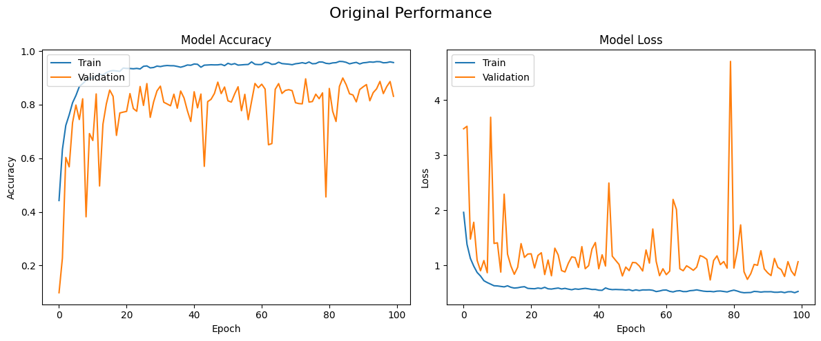
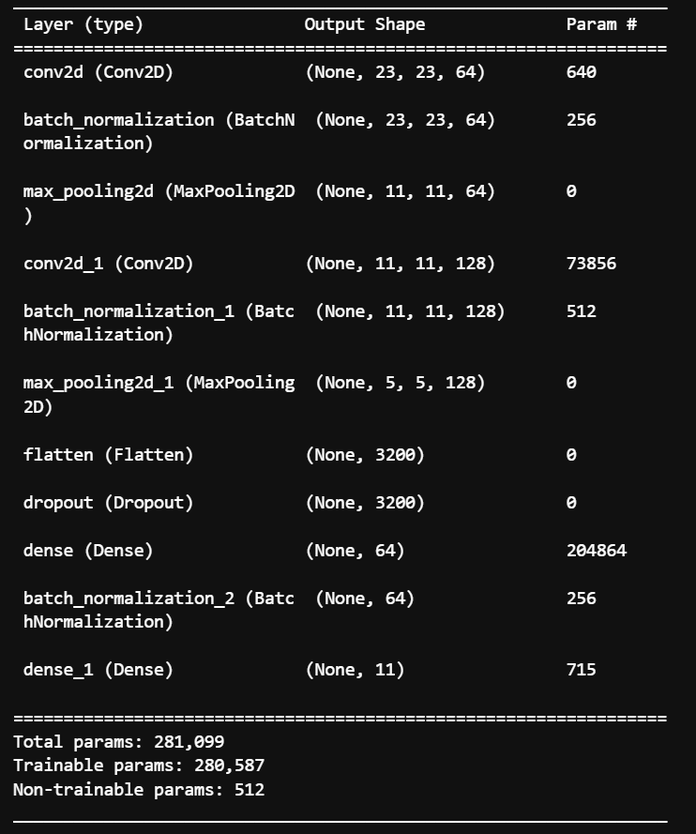
Model Training for 23 x 23 (Original Dataset)
The graphs are quite noisy
The validation accuracy seems acceptable while validation loss seems high (above 1.0)

Slide 8
Model Training for 23 x 23 (Original Dataset)
The graphs are quite noisy
The validation accuracy seems acceptable while validation loss seems high (above 1.0)

Slide 9
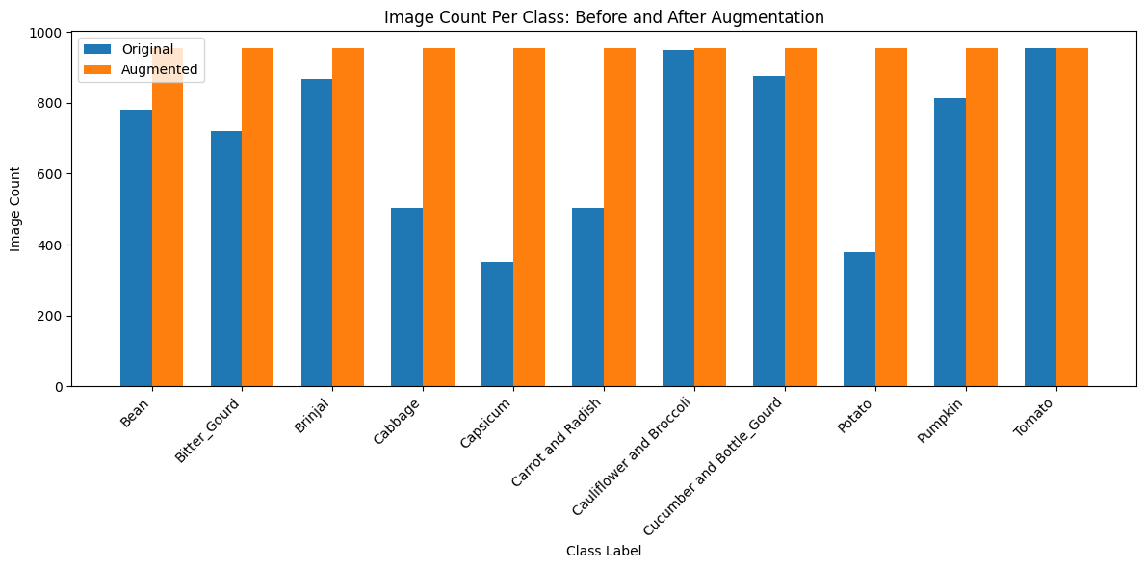
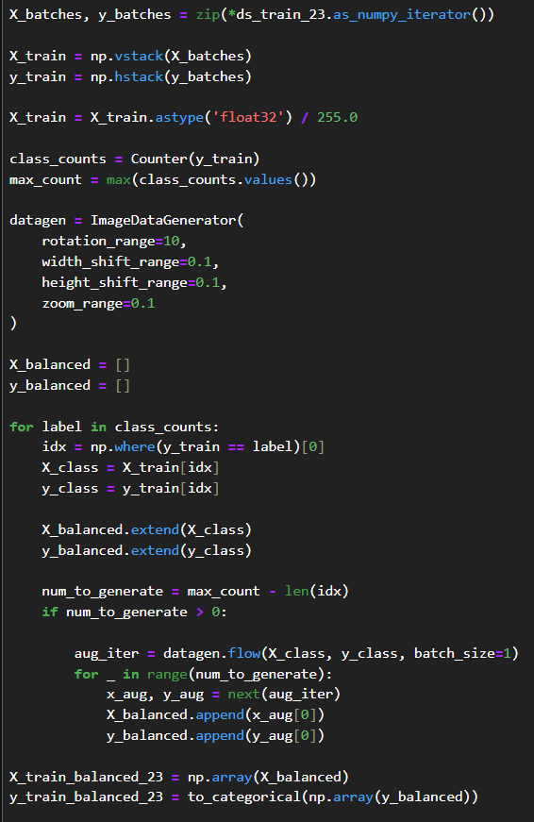
Data Augmentation
Using ImageDataGenerator, I was able to create new data to balance all the datasets

Slide 10
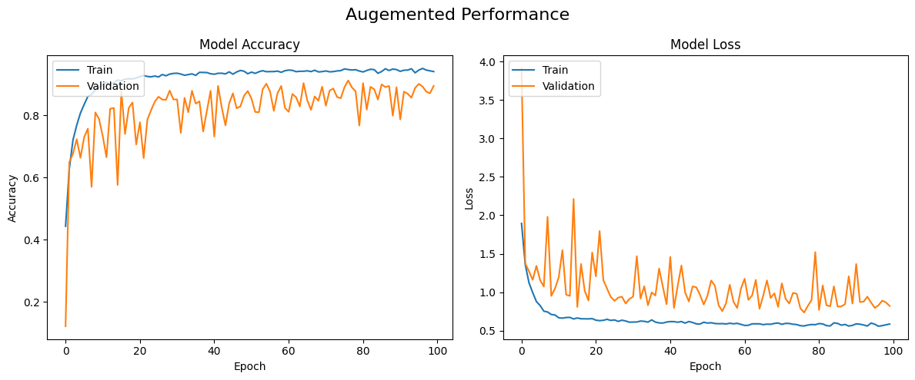
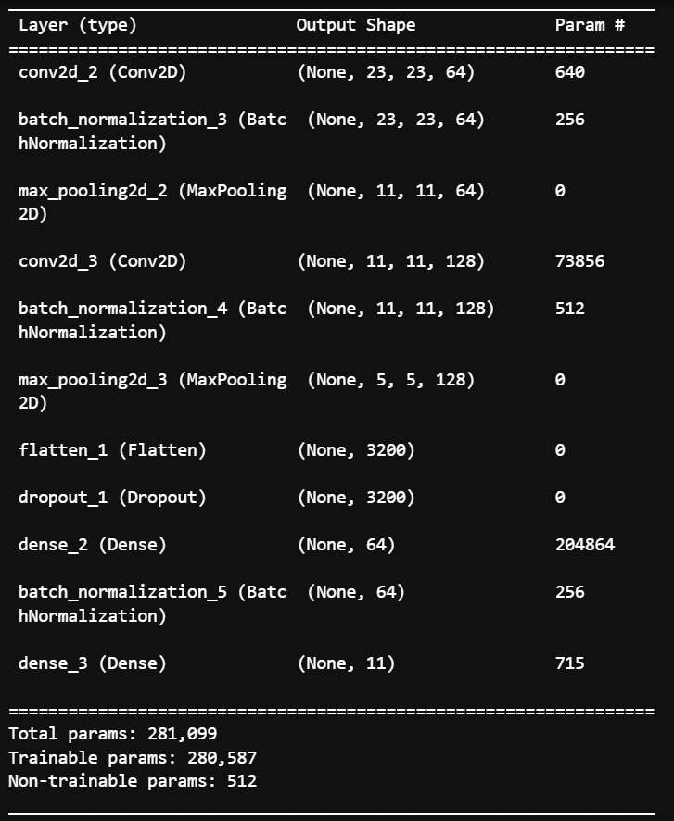
Model Training for 23 x 23 (Augmented Dataset)
Less noisy, improvement over original
Could still be improved

Slide 11
Learning Rate Scheduler
Created a learning rate reducer to improve results

Slide 12
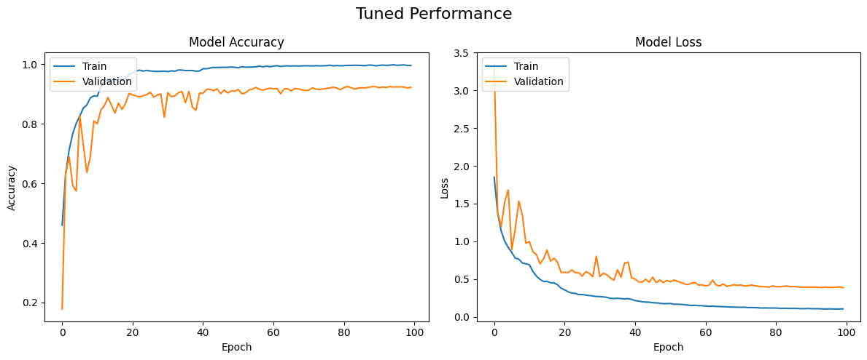
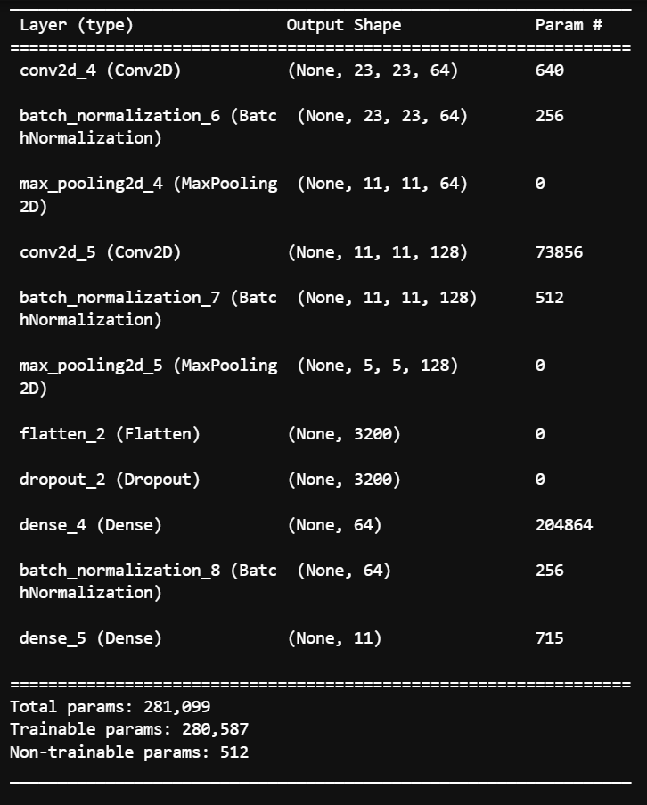
Model Training for 23 x 23 (Tuned Dataset)
Much less noise
Graph stabilises after 40 epochs

Slide 13
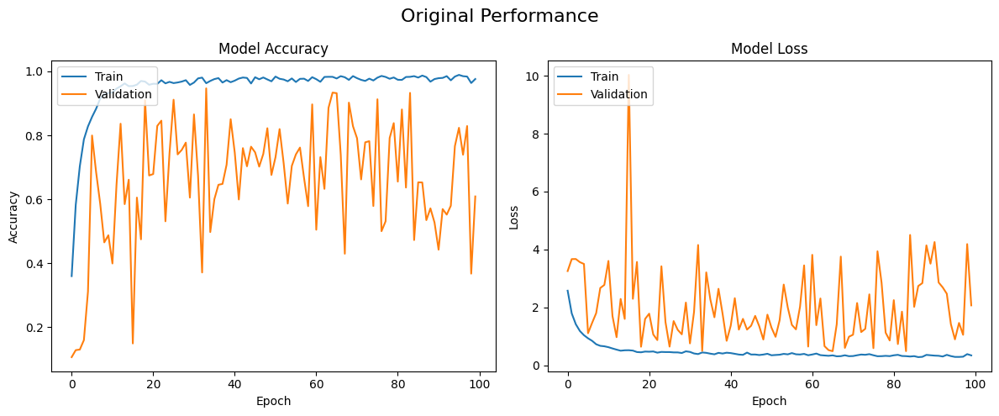
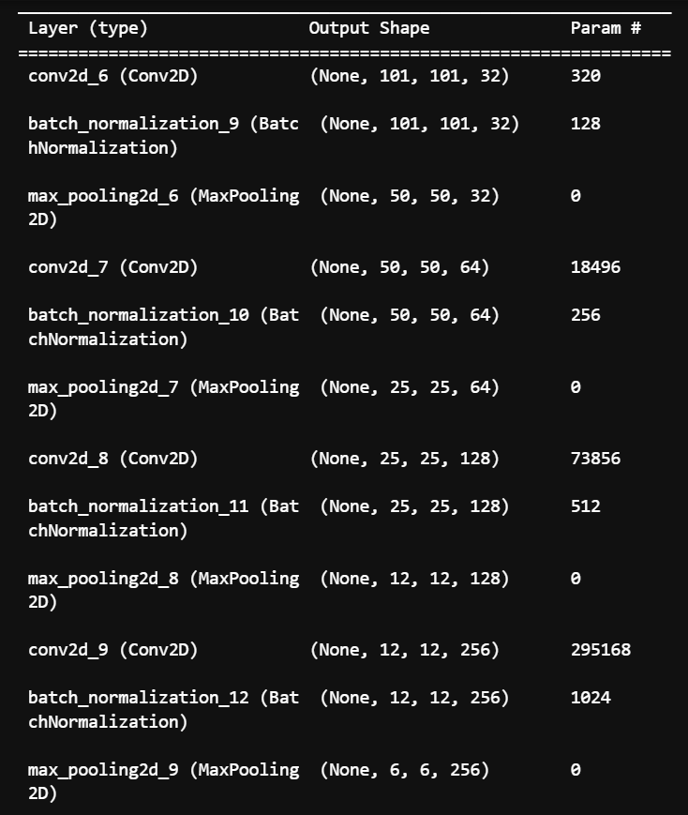
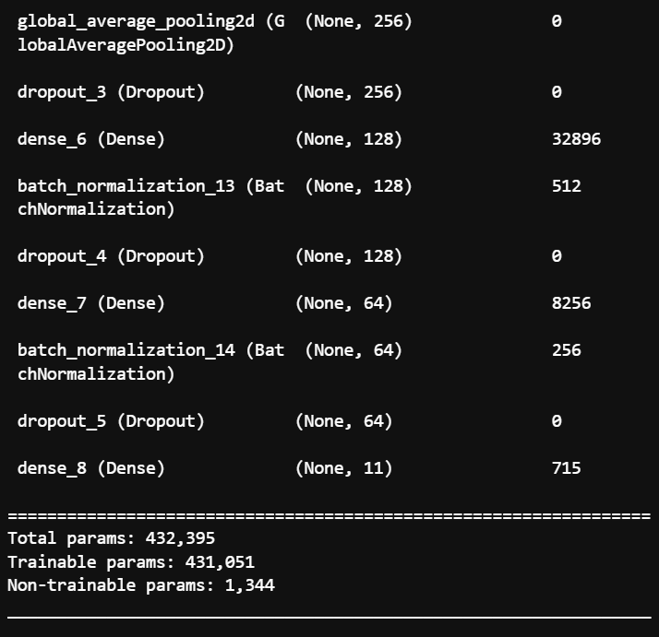
Model Training for 101 x 101 (Original Dataset)
Quite a bit of noise
Results not very good

Slide 14
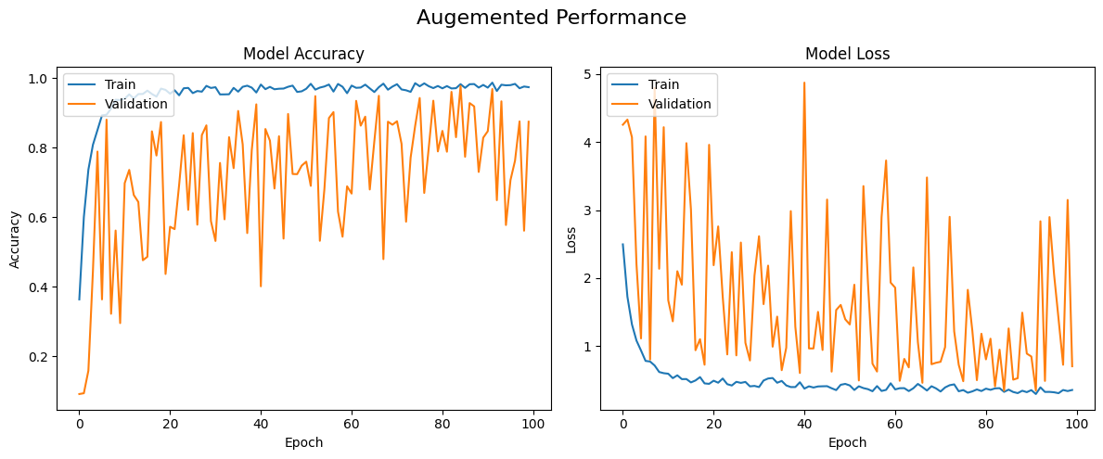
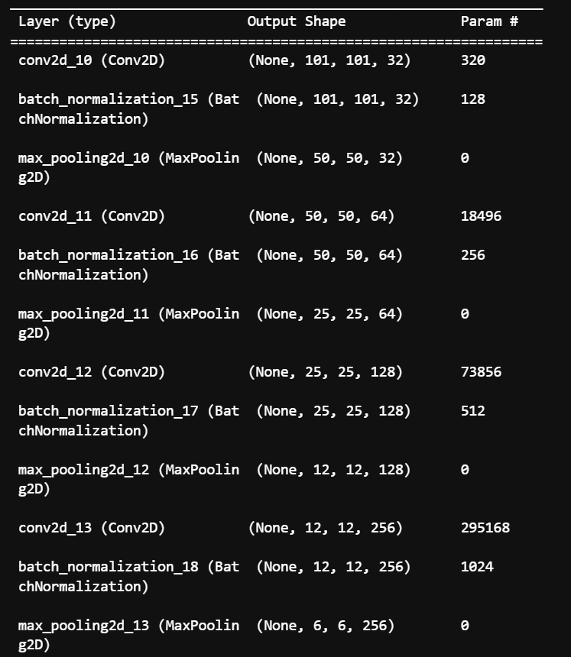
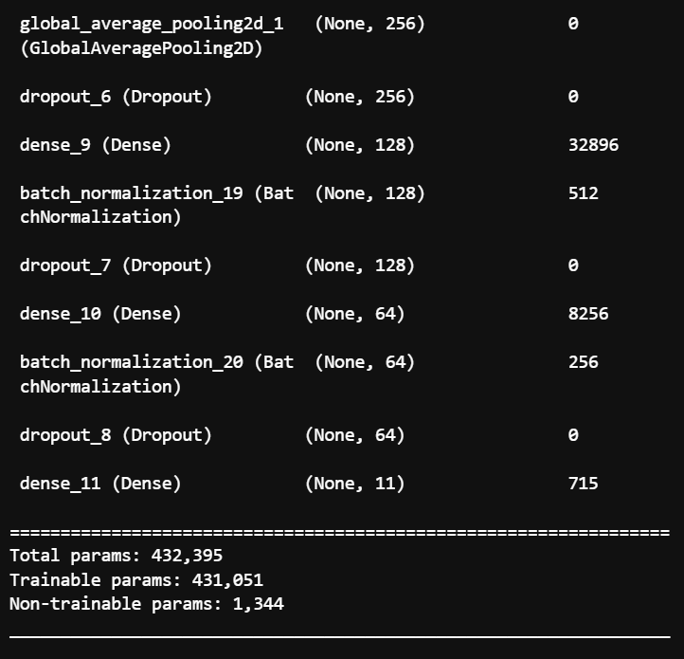
Model Training for 101 x 101 (Augmented Dataset)
Validation Loss slightly improved
Still a lot of noise, requires learning rate reducer to improve

Slide 15
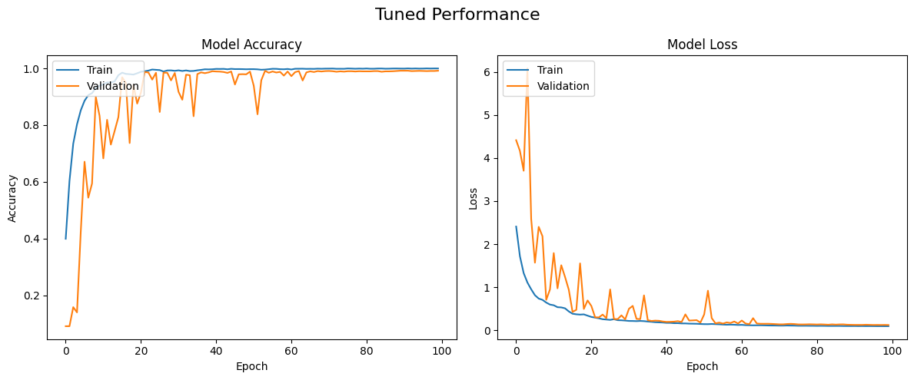
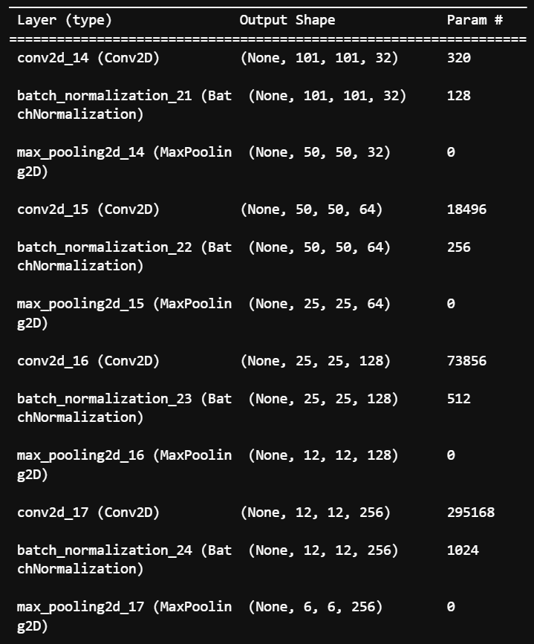
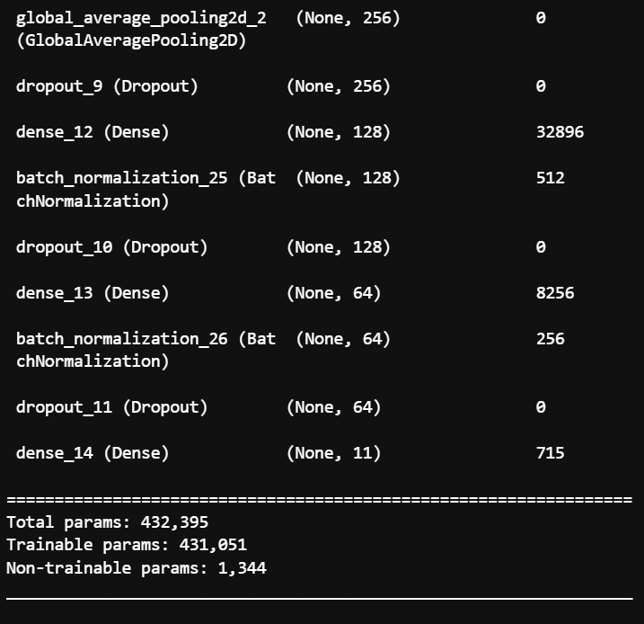
Model Training for 101 x 101 (Tuned Dataset)
Much less noise
Graph stabilizes after 40 epochs
Validation accuracy and loss are very good

Slide 16
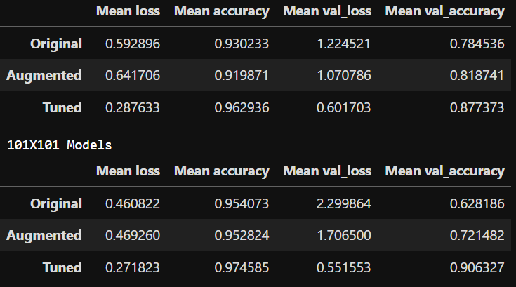
Model Evaluation
We can see that the tuned models were the best

Slide 17
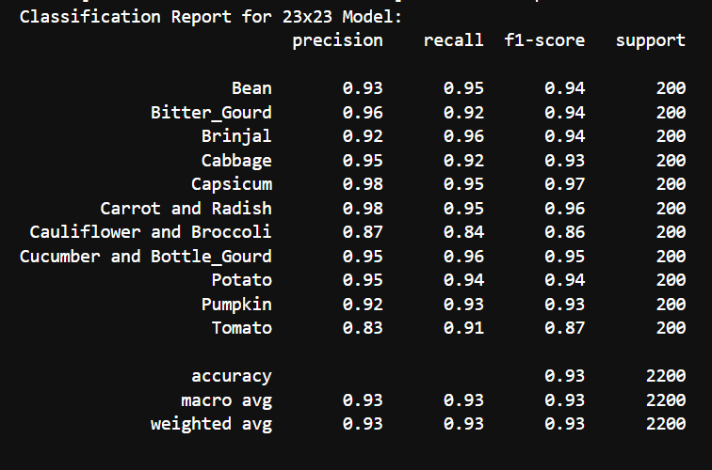
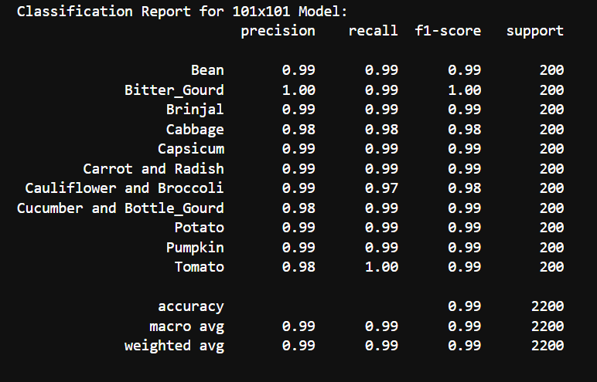
Model Evaluation
From the classification report, we can see that our 101x101 model has performed very well with a precision, recall and f1-score of all around 0.99
The scores for each vegetable are also very close to one another which shows that our model has learned to generalise well for all the different vegetables
Our 23x23 model has also performed quite well but there is slightly more variation like how Capsicum has a 98% precision while Tomato only has 83%

Slide 18
Final Conclusions
Overall, its seems that the 101x101 model has a better performance compared to the 23x23 model in terms of both accuracy and loss. However, the improvement in the performance is not that much and the 23x23 model already has a very good performance on its on
Another thing to note is that the 101x101 model took significantly longer to train compared to the 23x23 model in terms of both running the model and for the data augmentation where augmenting the 101x101 model took much longer compared to the 23x23 model
This means that if the perfect model is not needed and time is a huge concern, it would be better to go with a smaller image size like the 23x23 model since training it would be much shorter. However, if the goal is to have the best model possible, it would make more sense to use an even larger image size like the 101x101 model though in some cases like this one, the improvement won't be very drastic

